Slide 1
Modeling the population dynamics with adaptive exponential integrate and fire (AdExp) model neuron in newborn rat cortical networks
11th of July at OCNC 2019
Heidi Teppola-Gürel
heidi.teppola@tuni.fi
University of Tampere
Tutor: Cliff Kerr

Slide 2
The aim of the project
To model population dynamics of the excitatory and inhibitory neurons
To model the contribution of AMPA, NMDA and (GABA_{A}) receptor conductance on to the population activity
To compare the simulated population dynamics to the experimentally recorded multi-unit spike activity under AMPA and NMDA receptor antagonists

Slide 3
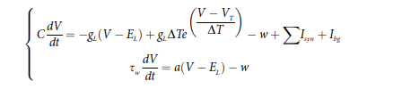
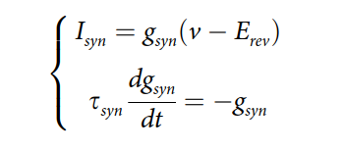
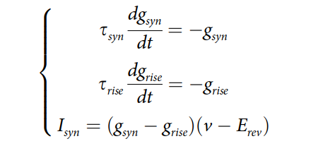
Spiking AdExp neuron model for excitatory and inhibitory neurons with synapse model

Slide 4
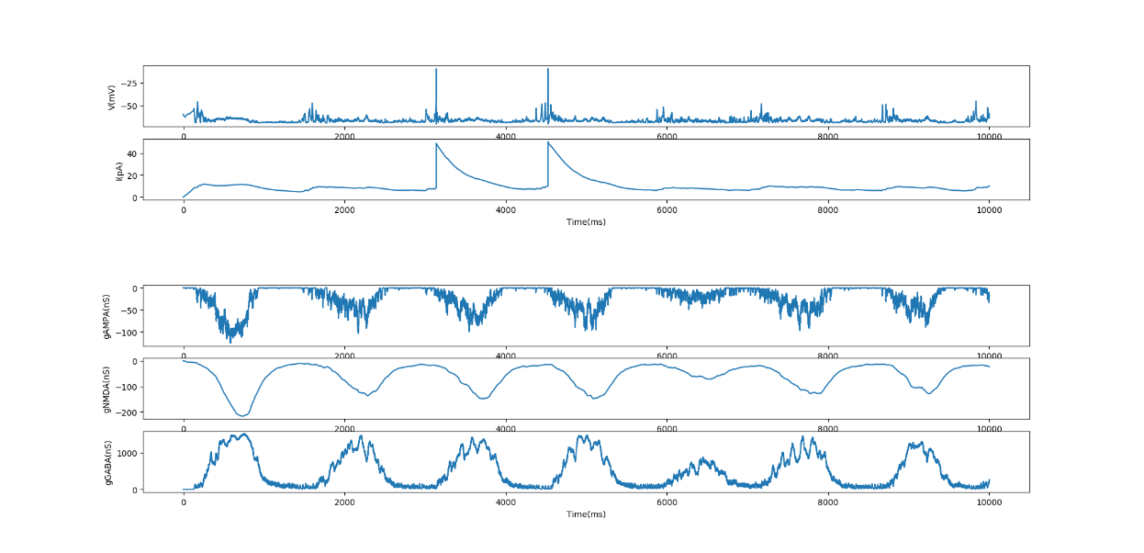
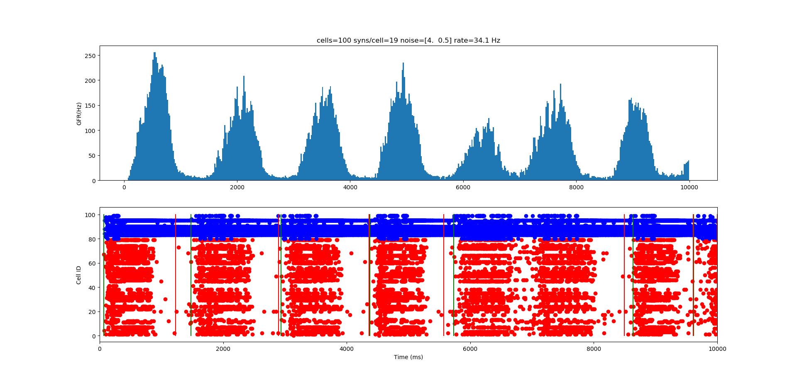
Simulation of population activity with all conductances

Slide 5
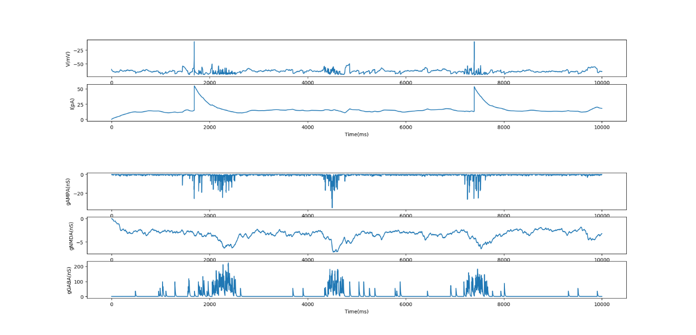
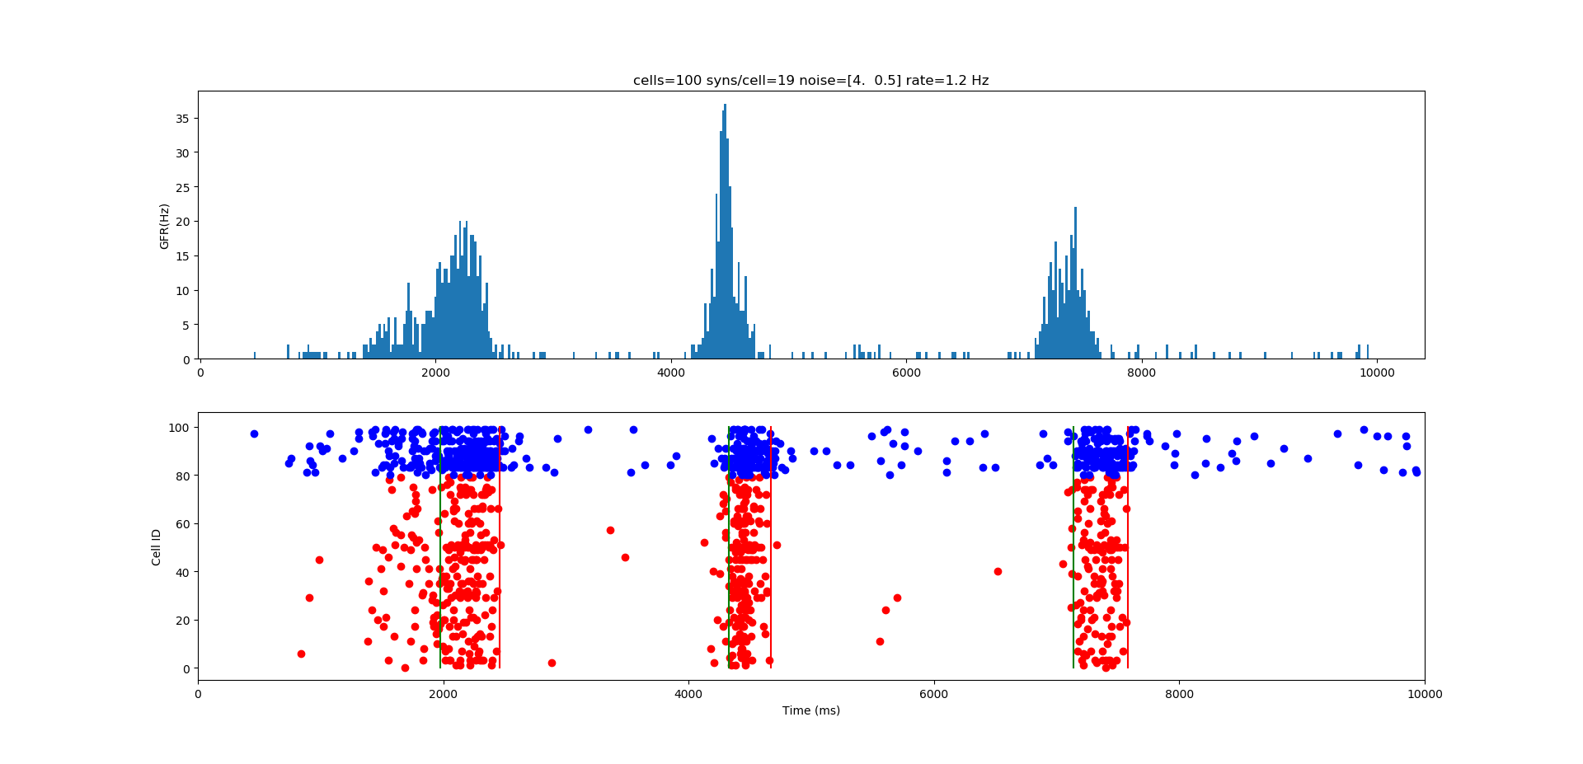
Simulation of population activity with supressed NMDA receptor conductance

Slide 6
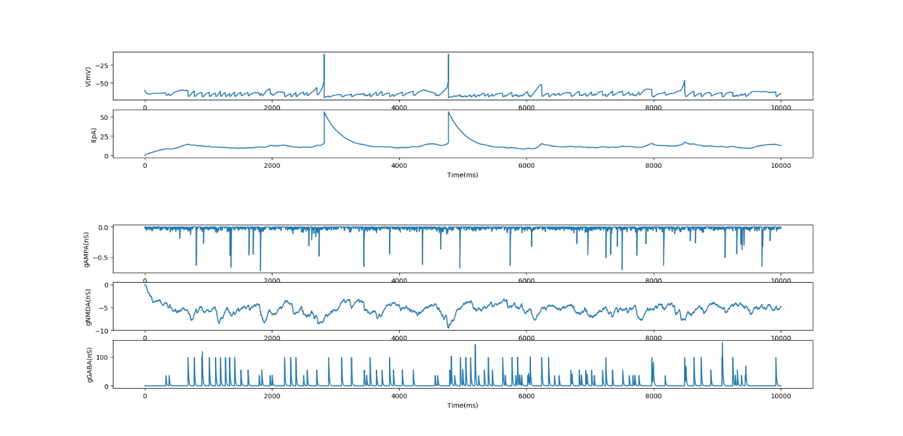
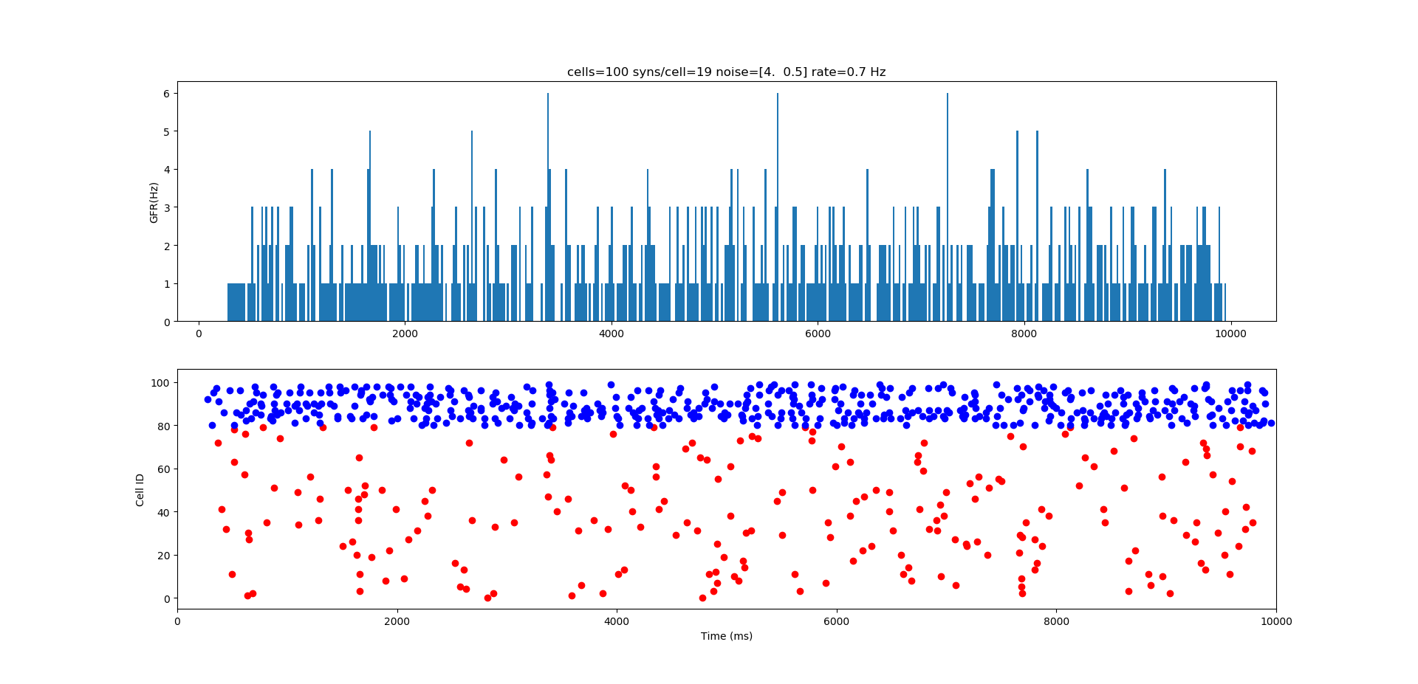
Simulation of population activity with suppressed AMPA receptor conductance

Slide 7
Simulation of population activity with disinhibited GABA_{A} receptor conductance

Slide 8
Comparison to experimental data

Slide 10
Acknowledgement
My tutor: Cliff Kerr
Organizers:
Eric De Schutter
Kenji Doya
Thank you all!

